Slide 1
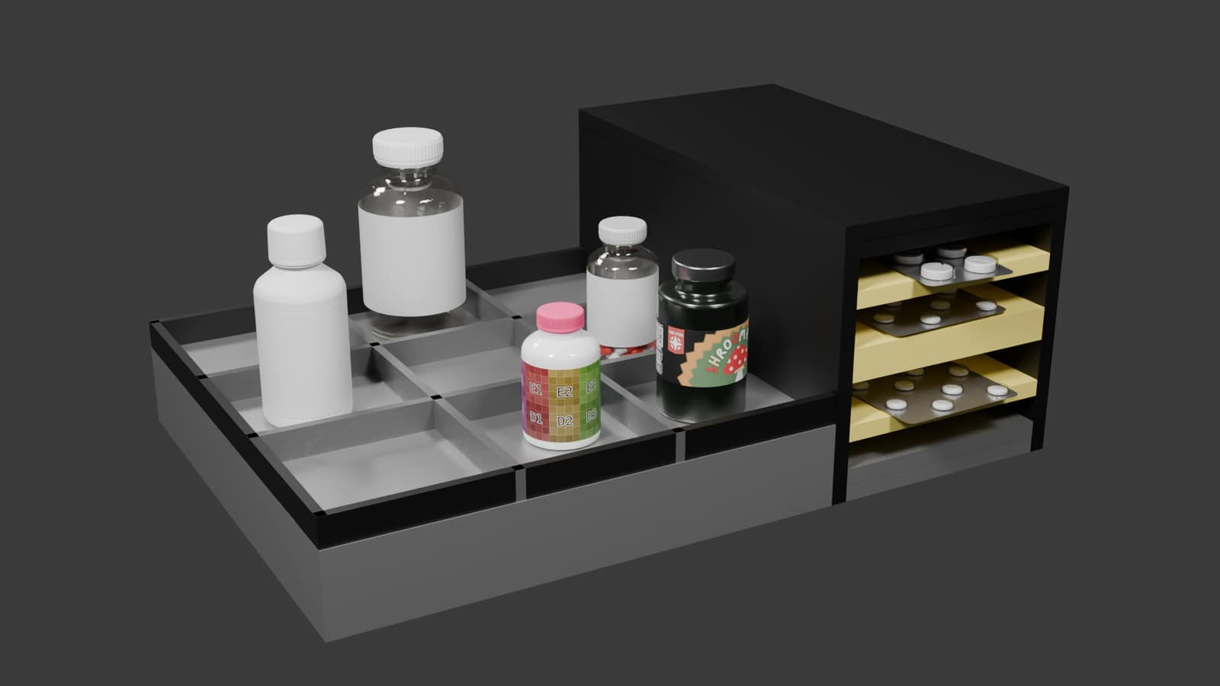
HACKFORGE LOGIX
MediSync
Medication
Tracking
Desk and portable concepts for reminders and event tracking; the Wokwi simulation is in progress.
Concept render — not a physical device
Primary: Open Innovation | Secondary: AI/ML + Cybersecurity

Slide 2
Problem Statement
01
Medication routines
Different schedules and packaging make daily tracking harder.
02
Mixed packages
Bottles, liquids and blister packs have different sensing limits.
03
Uncertain status
A reminder or sensor change cannot establish that a dose was taken.
MediSync targets people managing medicines and their authorized helpers.

Slide 3
Existing Solutions
EXAMPLES REVIEWED
OFFERING / MEDISYNC POSITION
Hero dispenser
Automated dose sorting, scheduled dispensing and caregiver alerts.
Aidia Smart Bottle
Connected bottle-based reminders and patient support.
Shaztech open build
ESP32 dispenser with editable firmware, PCBs and printable parts.
Open Innovation lesson
Use public builds as references; validate safety and usability locally.
MediSync today
Wokwi prototype remains in progress; offline app and adaptive ML are planned.
Evidence limit
Sensor cues need validation; an event does not prove a dose was swallowed.
Notes:
Landscape sources checked 7 Oct 2026; product descriptions reflect manufacturer pages and the open-source project's README, not independent performance testing.
Hero Smart Dispenser overview: https://herohealth.com/medication-management/
Hero dispensing and caregiver alert details: https://support.herohealth.com/en/articles/8058271-how-does-the-hero-dispense-medications
AdhereTech / Aidia Smart Bottle: https://adheretech.com/
Shaztech open-source automatic dispenser README: https://github.com/Shaztech/Pilldispenser/blob/main/README.md
MediSync status and limitations reflect the team's supplied project material. Wokwi prototype remains in progress and needs validation; an event does not prove ingestion.

Slide 4
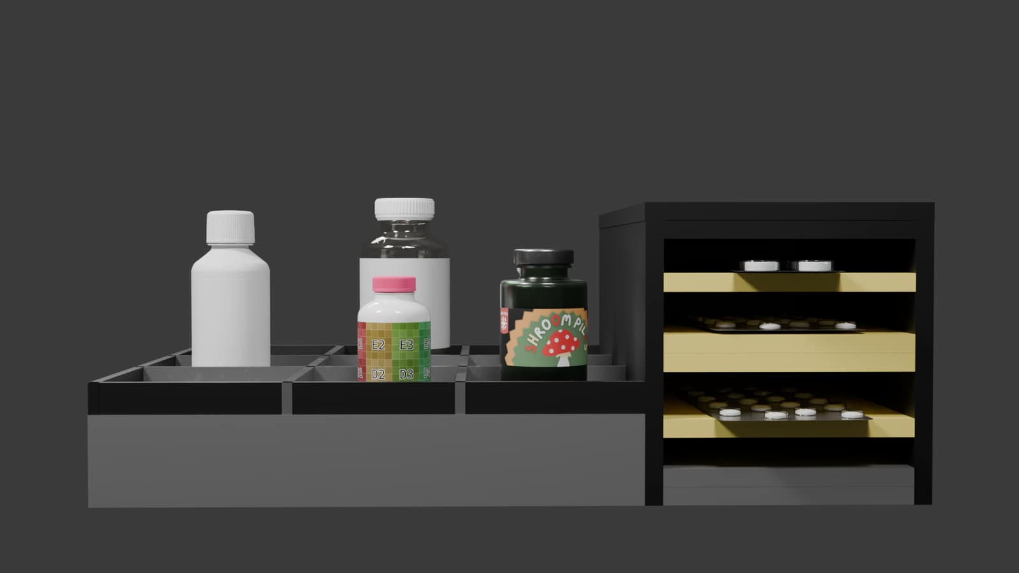
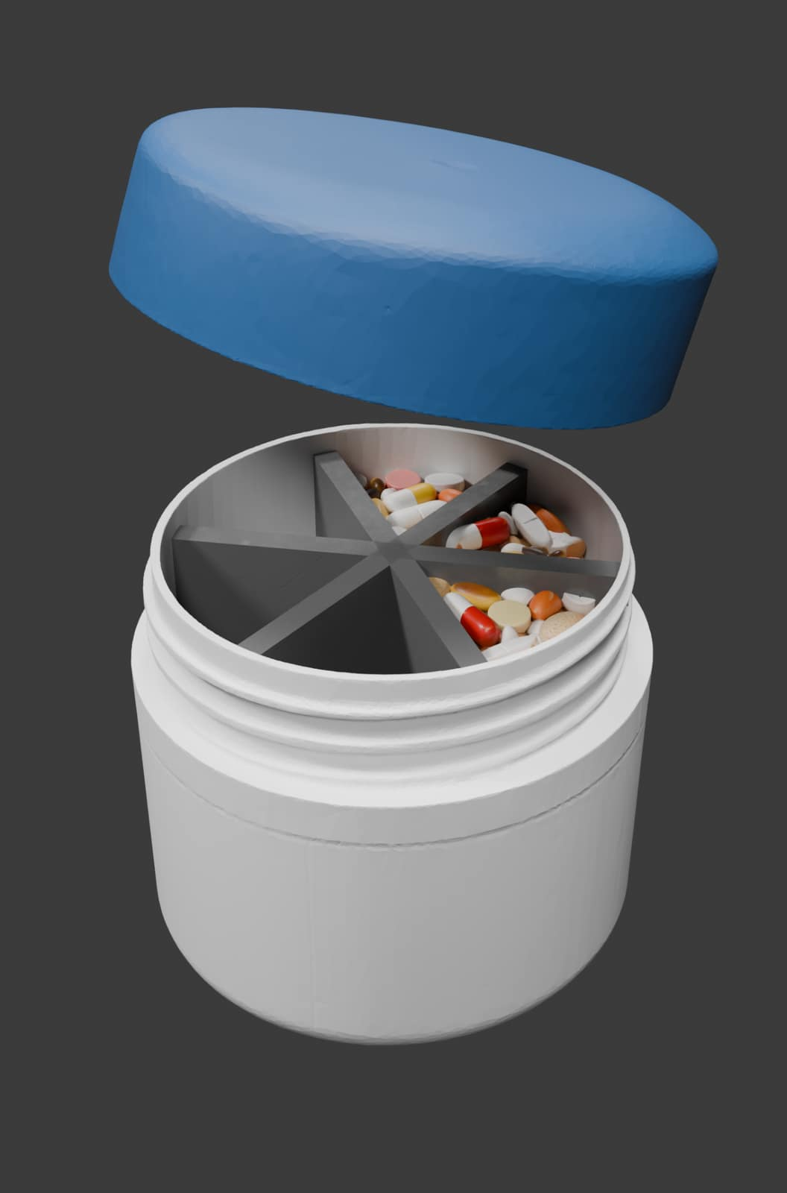
Proposed Solution
Home / desk
12 positions: 3 pill/container, 3 liquid and 6 blister.
Portable
6 compartments for personal use or travel.
Home / desk concept render
Portable concept render

Slide 5
Key Features
FEATURE
STATUS
CURRENT DEMO
LIMITATION
Scheduled reminders
Simulated
Compressed clock + OLED / buzzer / LED
Wokwi validation pending
Weight event candidate
Simulated
One adjustable HX711 model
Candidate only; not ingestion proof
Blister cue
Input cue
IR EVENT (SIM) button
No physical IR sensor connected
App, adaptive ML, cloud AI, hospital dashboard and TEE remain planned.
Sensor events do not confirm that a dose was swallowed.

Slide 6
Technical Approach
Wokwi flow: reminders create sensor-event candidates for user review.
1
2
3
4
Schedule
Remind
Sense
Record
Register slot
and schedule
OLED, LED and
buzzer cues
Simulated HX711;
IR button cue
Log candidate or
leave unresolved
No phone app or cloud connection; sensor cues cannot confirm a dose was swallowed.

Slide 7
Technology Stack
CURRENT SIMULATED STACK
PLANNED — NOT IMPLEMENTED
ESP32 / Arduino C++ / PlatformIO
Wokwi HX711 model + SSD1306 OLED
NeoPixel ring, buttons and buzzer
Offline phone app and local data
Adaptive ML with user review
Optional cloud AI with consent
Hospital dashboard + audit trail
TEE on supported phones (future)
One adjustable load input; readings and slot state are simulated.
Wokwi firmware is in progress and needs validation before a live demo.
Notes:
The ESP32 / PlatformIO firmware and Wokwi project are supplied for simulation. The Wokwi sequence still needs validation. The app, adaptive ML, offline and cloud AI, hospital dashboard, and TEE are planned only.

Slide 8
Prototype Demo
Wokwi simulation is in progress; validate this sequence before pitching.
01
02
03
04
Baseline
›
Reminder
›
Sensor cue
›
Event log
Set load ~0.50 kg; ADD 1 Vitamin_D 08:00; BASELINE 1
NOW 1; acknowledge with SELECT
Adjust to ~0.35 kg; optional IR EVENT (SIM)
CONFIRM 1; inspect serial event candidate
Capture OLED + serial output after validation; a sensor change is not ingestion proof.

Slide 9
Expected Impact
PEOPLE AT HOME
CARE SETTINGS
Give users and authorized helpers a clearer view of reminders awaiting follow-up.
A future dashboard could surface unresolved events for staff review, subject to workflow approval.
PORTABLE USE
EVIDENCE STATUS
The portable concept could support routines away from home; usability remains untested.
No adherence, clinical or time-saved outcomes have been measured.
Expected benefits remain hypotheses until sensor and user studies are complete.

Slide 10
ROADMAP
Future Scope
PHYSICAL VALIDATION
AI + HOSPITAL WORKFLOW
Build the desk and portable units; calibrate sensors across real packages and measure false event rates.
Evaluate offline and consent-based cloud AI after safety review; dashboard and audit trail remain planned.
CYBERSECURITY
LOCAL APP + ADAPTIVE ML
Plan encryption, role-based access and user-controlled sharing/deletion. Assess TEE on supported phones.
Build the offline app and local profile. ML suggestions stay subject to user review and approval.
All items here are planned; none is implemented in the current firmware.

